Slide 1
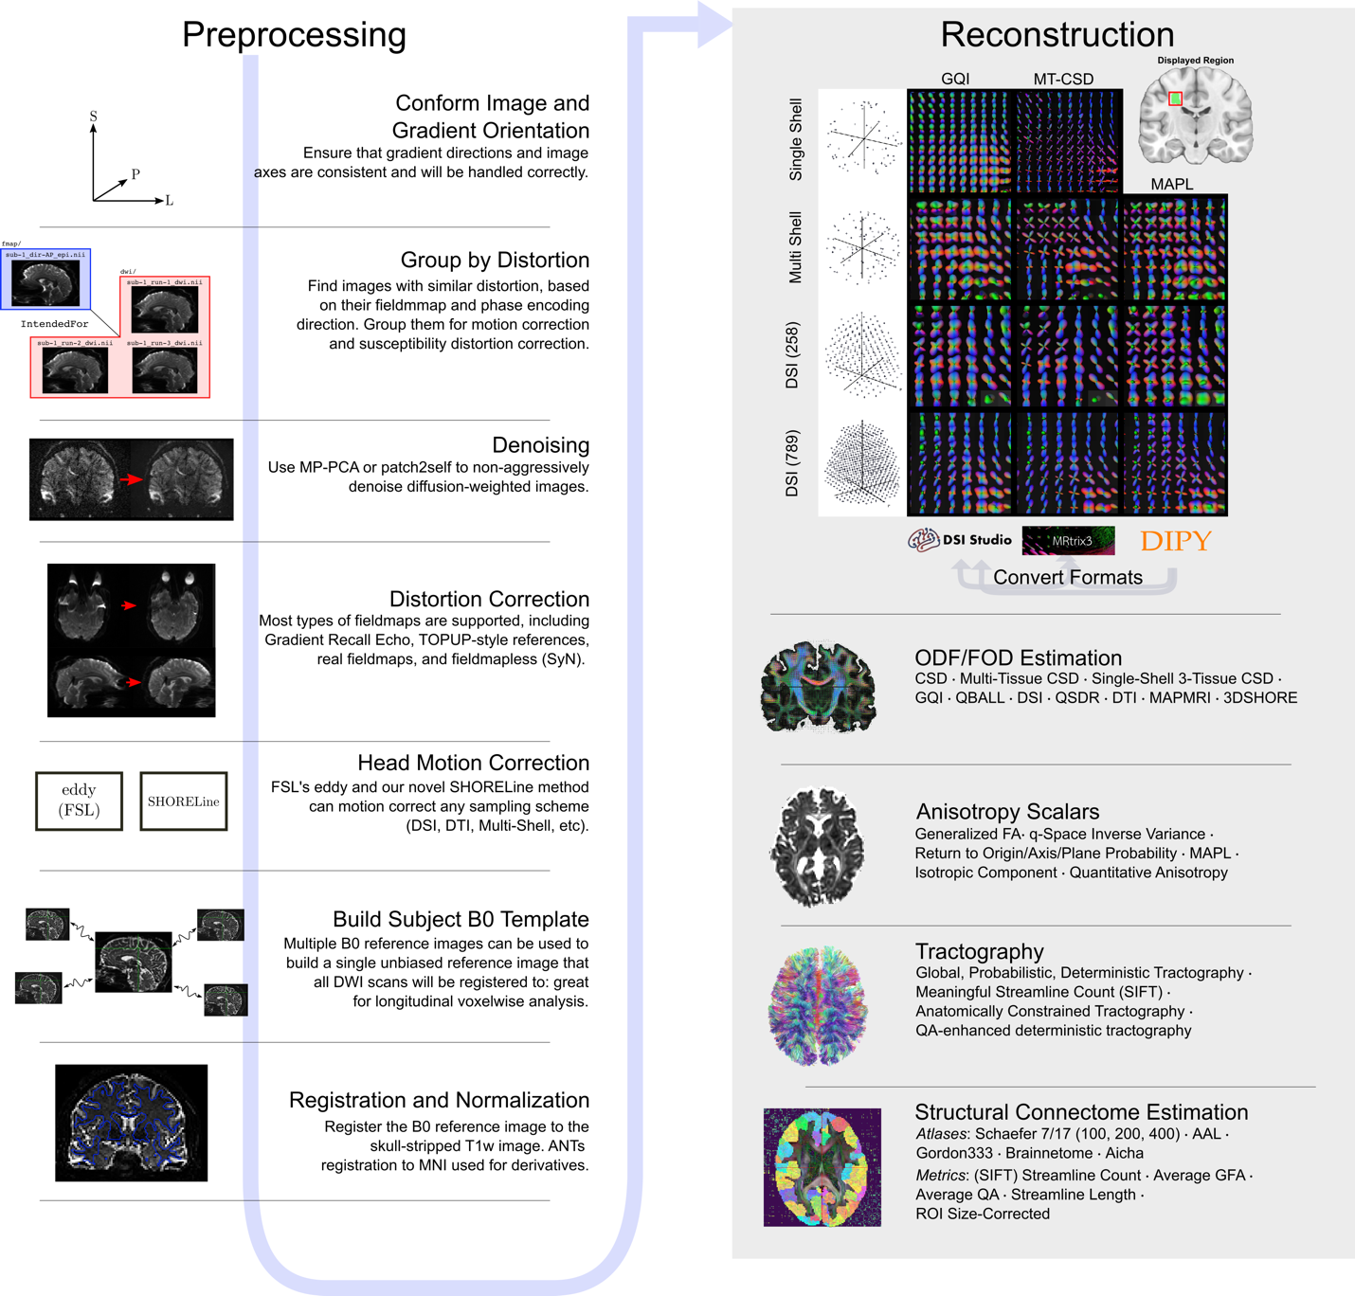
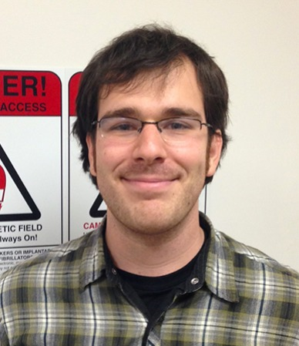
Diffusion Processing with QSIPrep in NiChart
>25,000 total downloads
Ingress preprocessed data from UK Biobank / HCP
Additional continuous integration testing on CircleCI
Custom reconstruction workflow
9,000 runs since NiChart version release
Matt Cieslak, Ph.D
Senior Scientist
Cieslak et al., Nature Methods 2021
Notes:
Not content to just have these kinds of pipelins for fMRI, Matt Cieslak, a senior scientist in our group, built QSIPrep
QSIPrep is a fully containerized pipeline that can handle nearly any diffusion imaging acquisition.
Because it is a bids app, it reads the imaging paramters from the meta-data encoded in BIDS and automatically configures to build appropriate and reproducible pipleines for the data.
Furthermore, in includes modular reconstruction workfows that are interoperable, allowing users to leverage tools from different software packages that often don’t play well together.
The paper describing it should be out shortly in Nature methods, but QSIPrep has already been downloaded around 6,000 times from dockerhub.

Slide 2
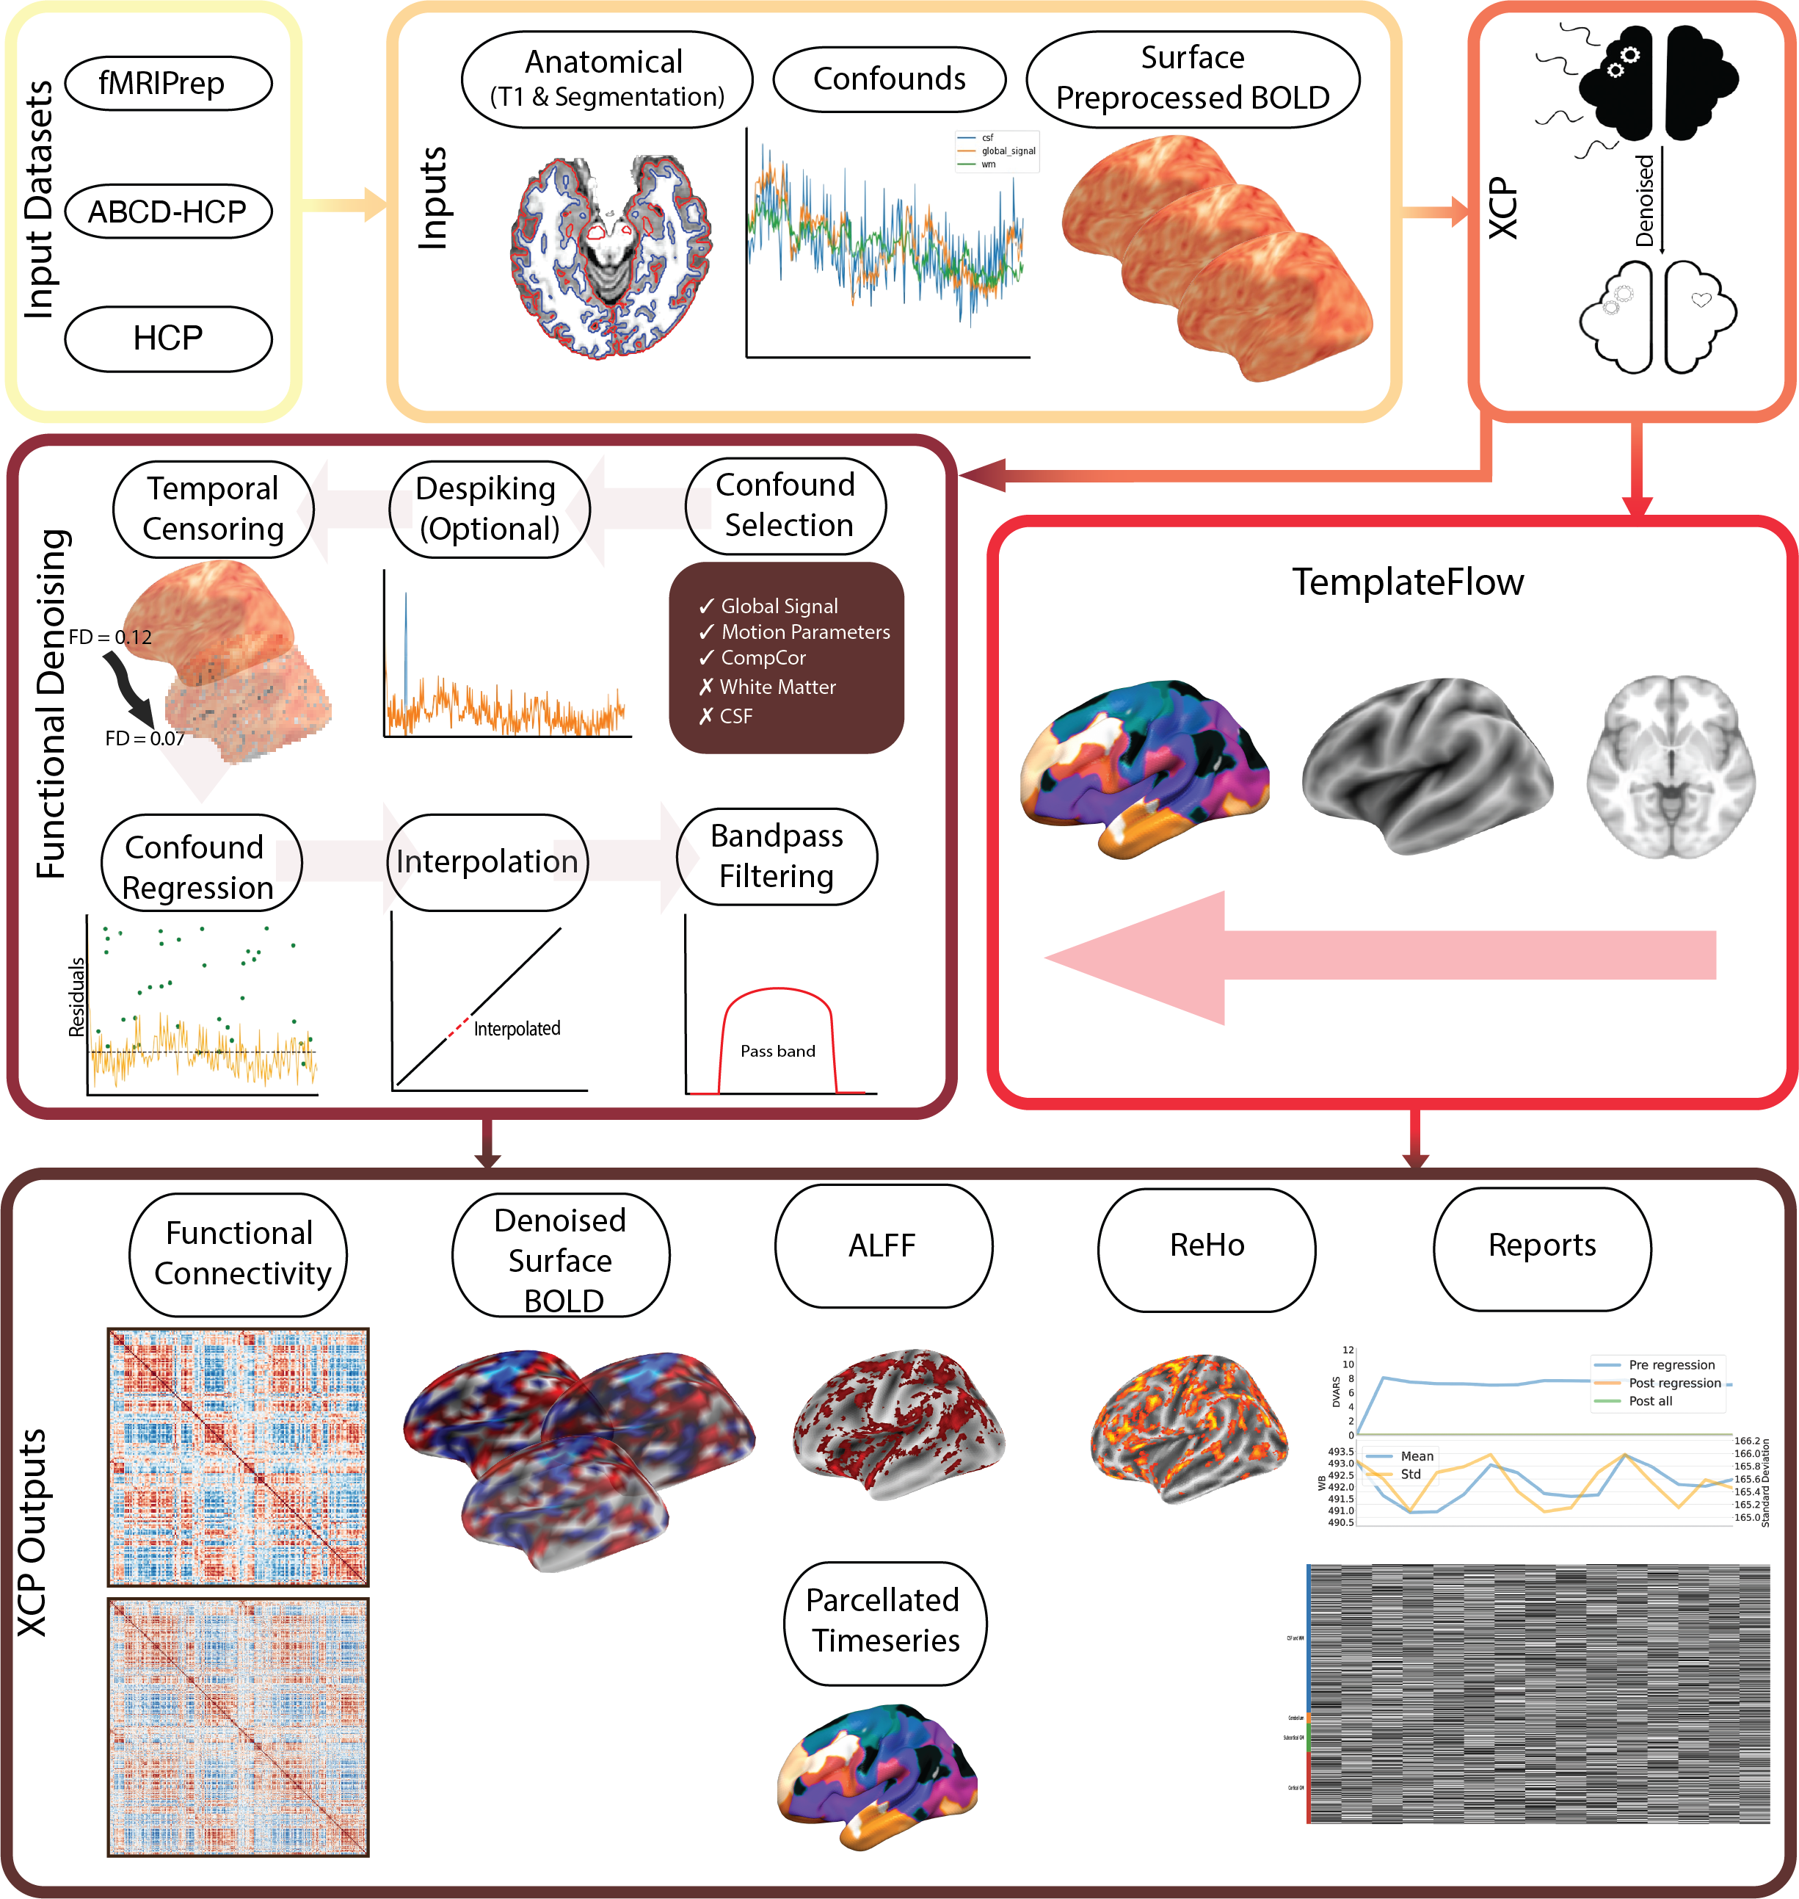

XCP-D for NiCharts
>10,000 total downloads
Fully-refactored in Nipype
Workflow to ingress minimally preprocessed data from UK Biobank / HCP
Extensive new continuous integration testing on CircleCI
Taylor Salo, PhD
Post-doctoral Software Engineer
Mehta & Salo et al., BioRxiv 2023

